Slide 1

Data Analyst & Data scientist
Coffee Quality
Sriram prasath.T

Slide 2
INTRODUCTION
DATA UNDERSTANDING
GETTING INFORMATION
FINDING MISSING VALUES
OUTLINER HANDLING
DATA VISUALIZATION

Slide 3
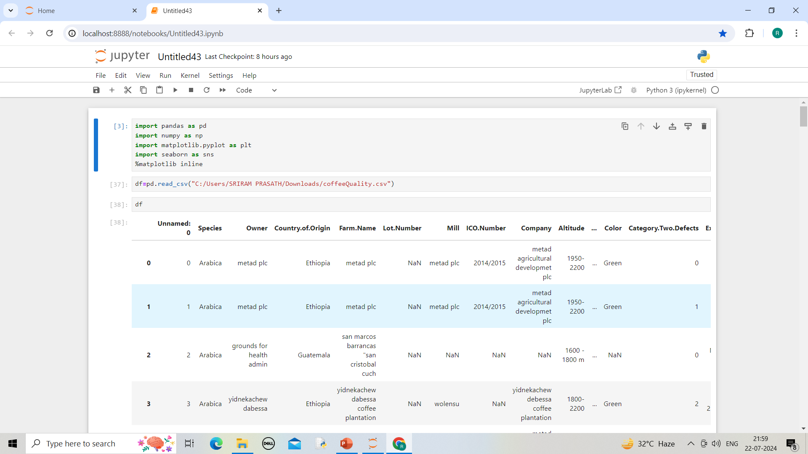
Data understanding
It is used to read the data & it returns no.of rows and columns

Slide 4
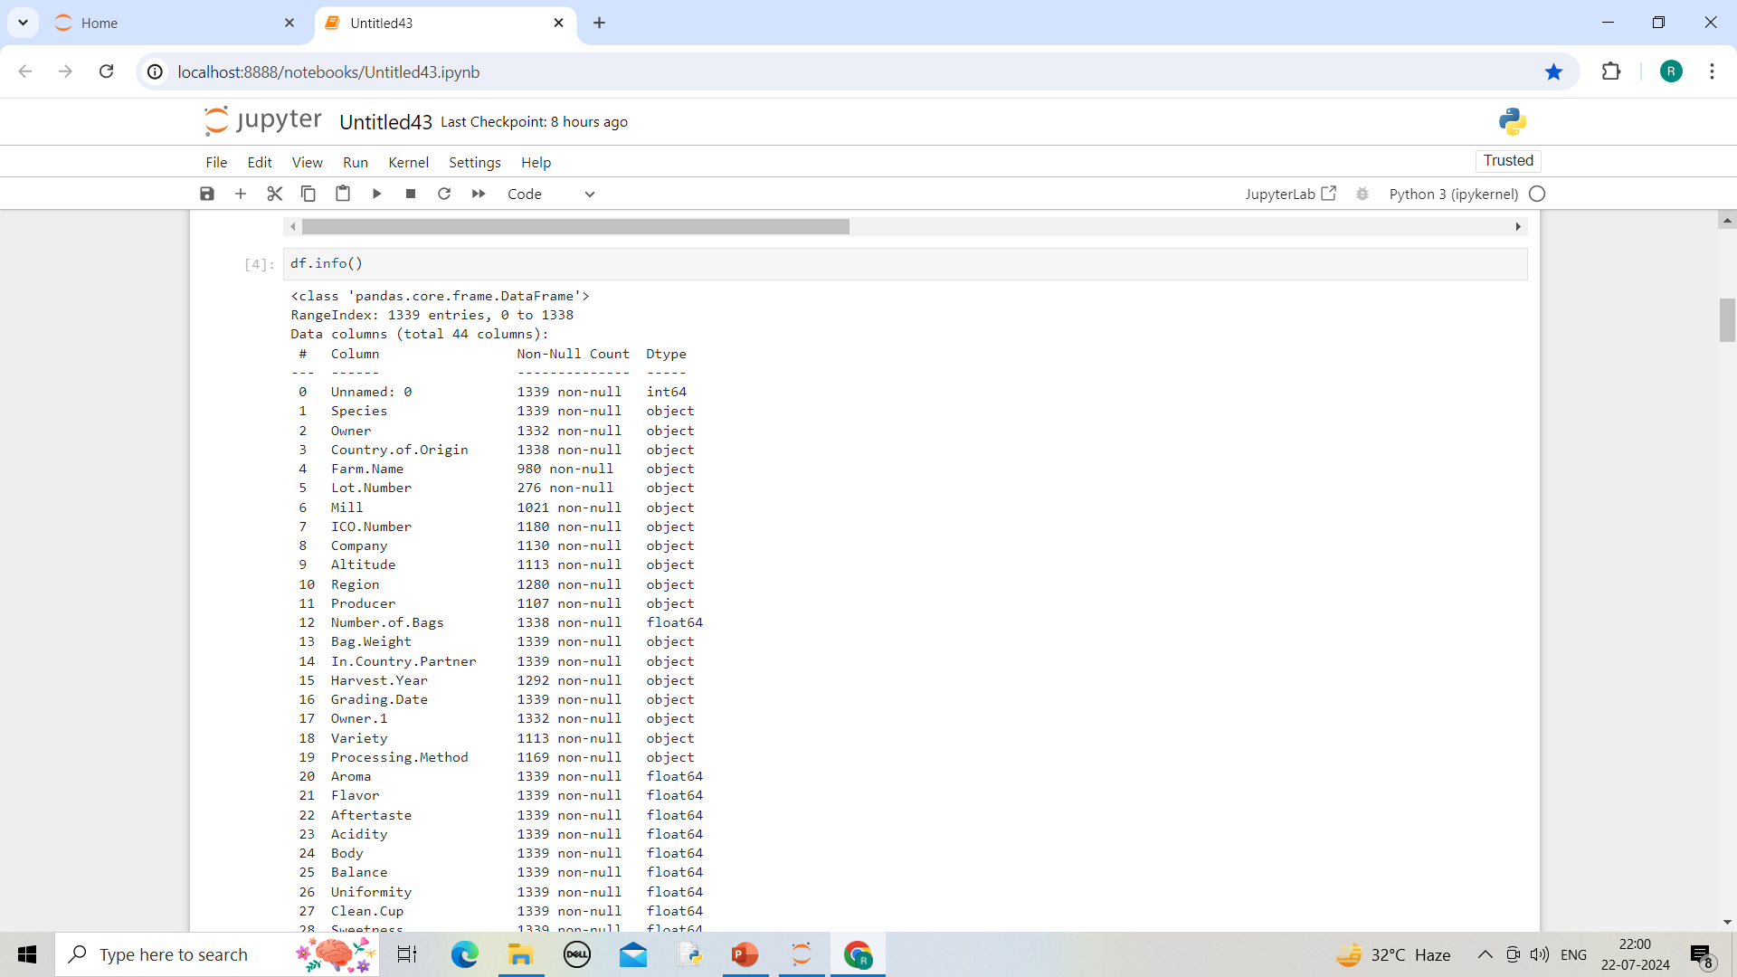
Getting information df.info() used to get information

Slide 5
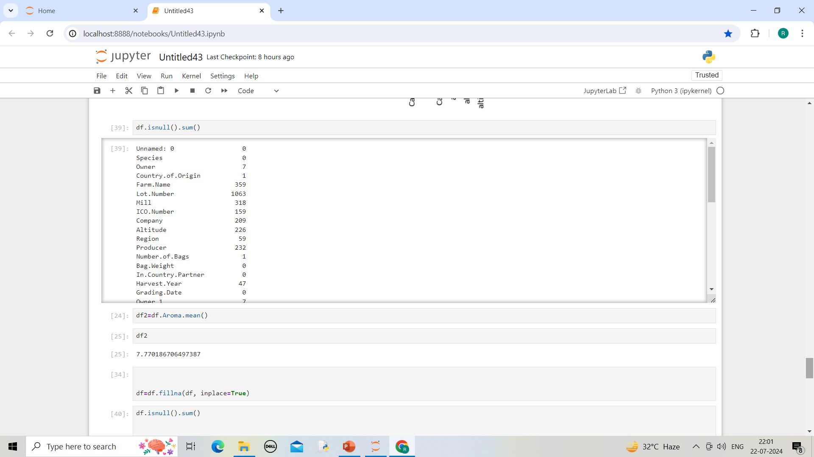
FINDING MISSING VALUE df.isnull().sum() used to find missing value. Mean() used to find average value

Slide 6
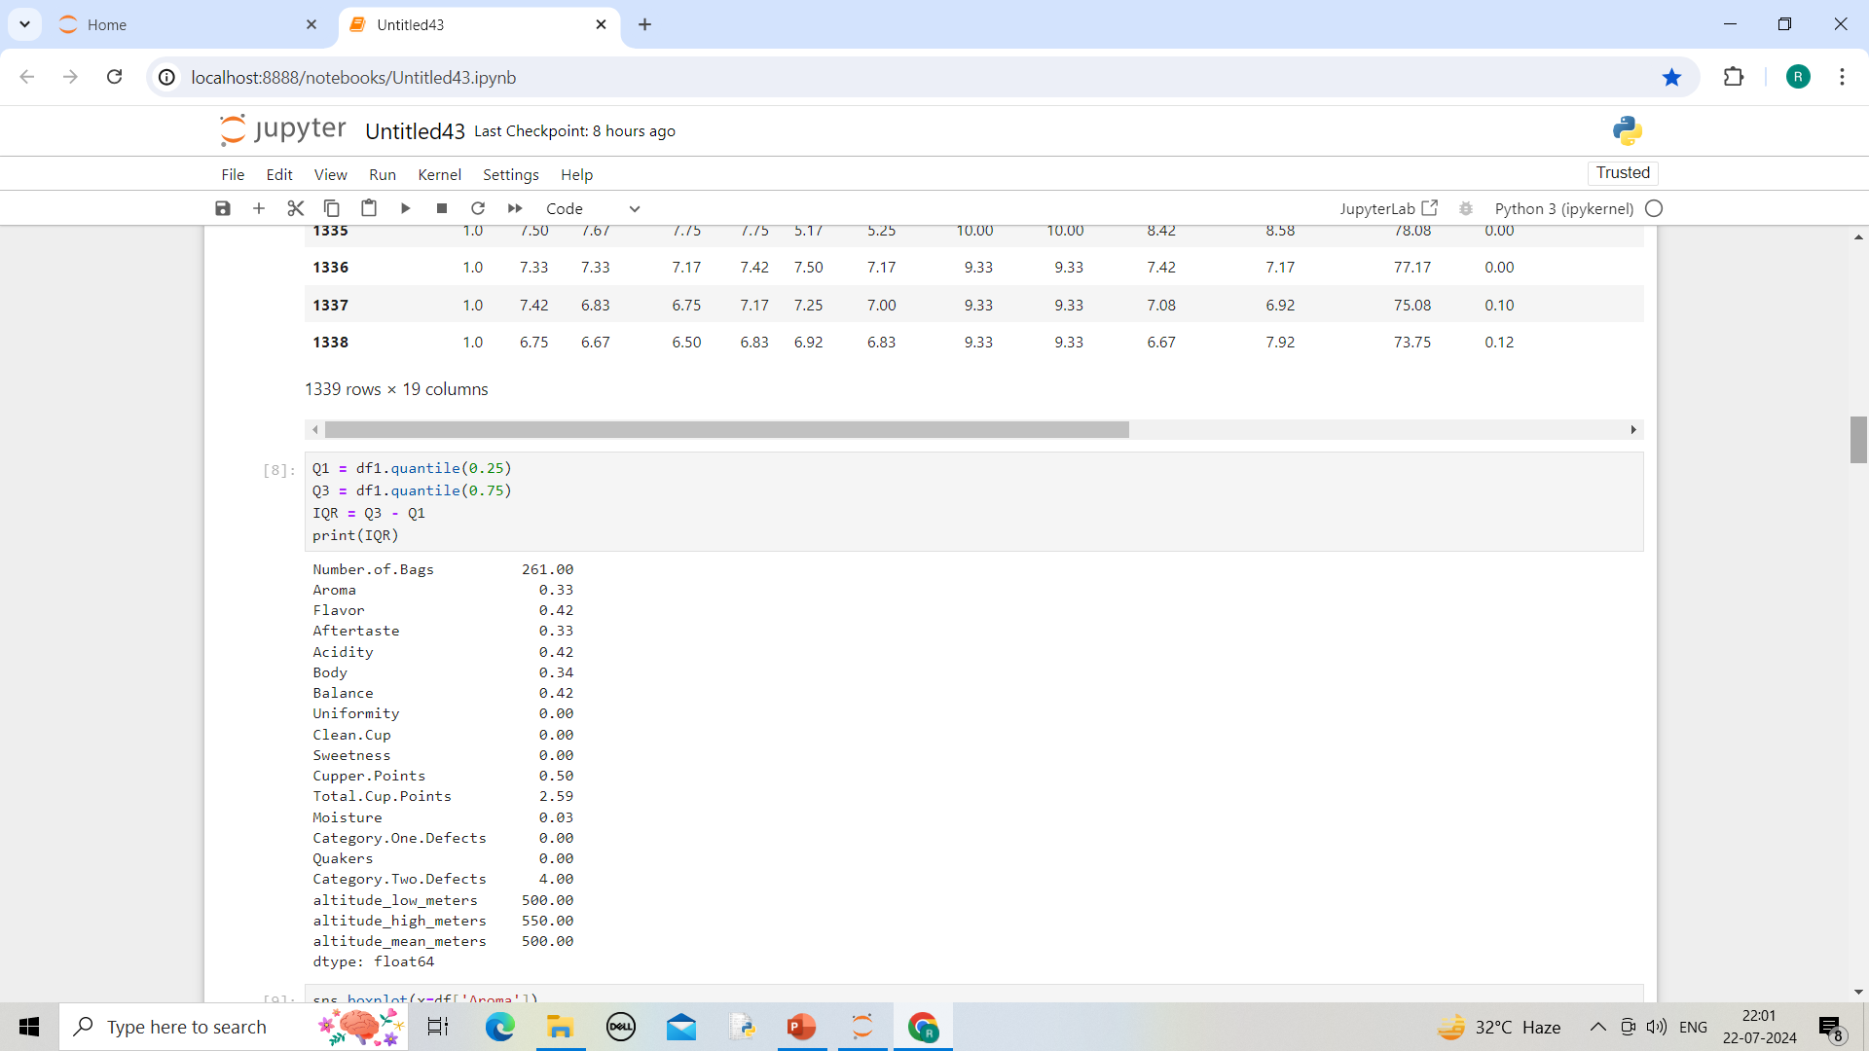
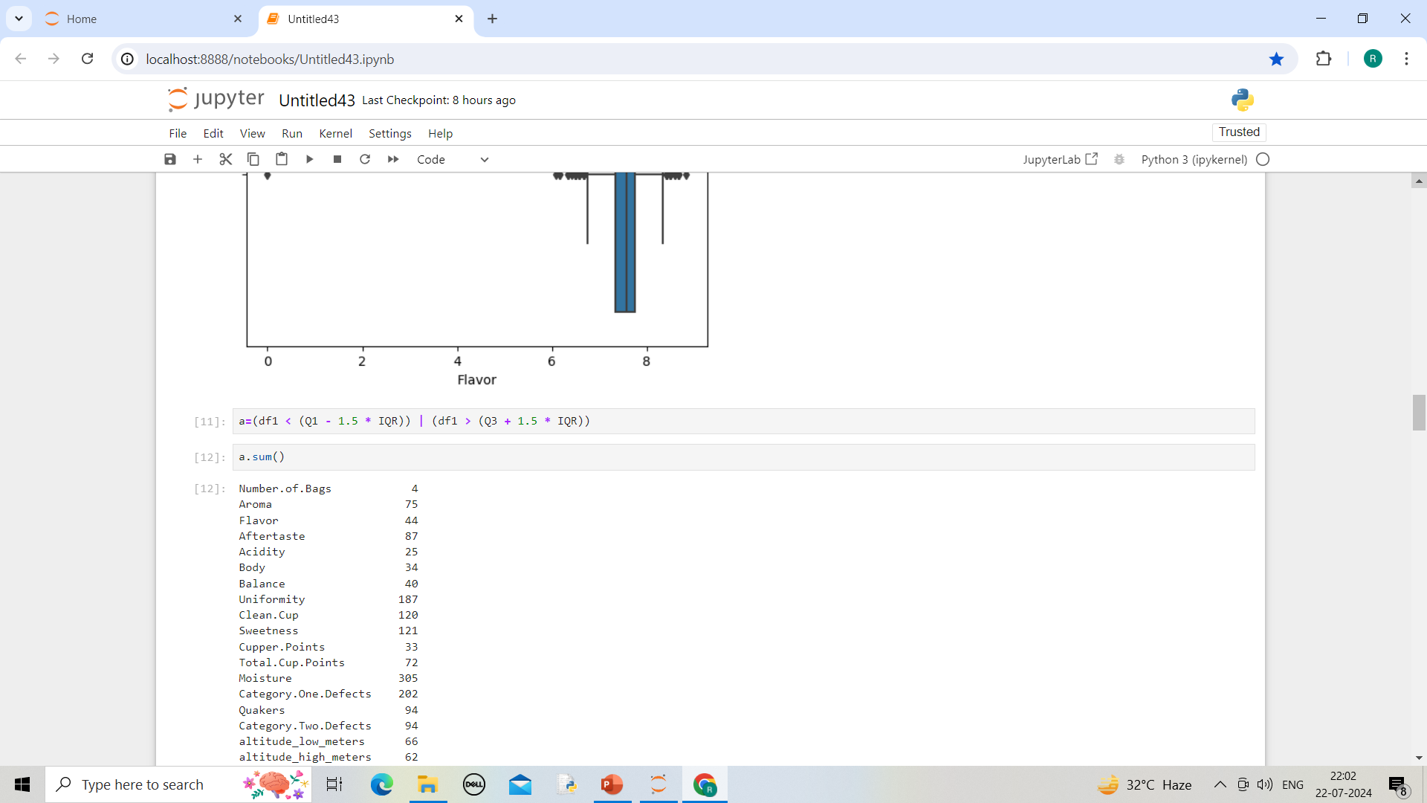

Slide 7
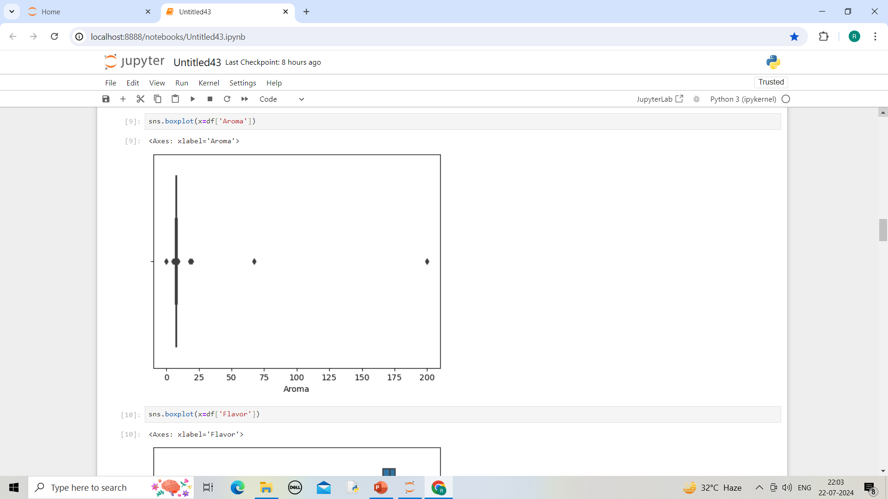
Box plot for aroma
Used to visualize the data in graphical representation

Slide 8
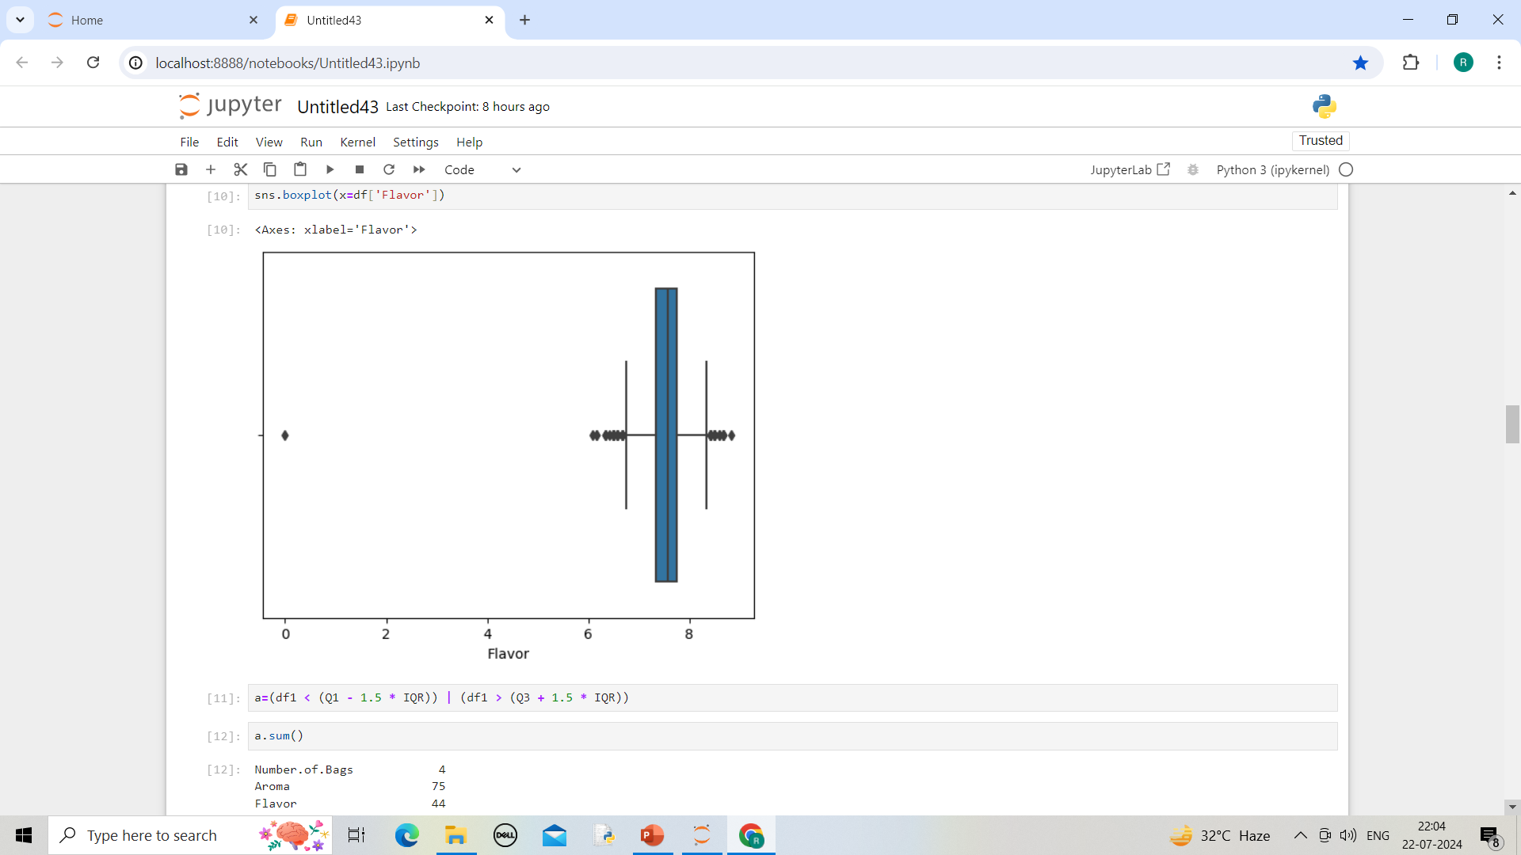
Box plot for flavor

Slide 9
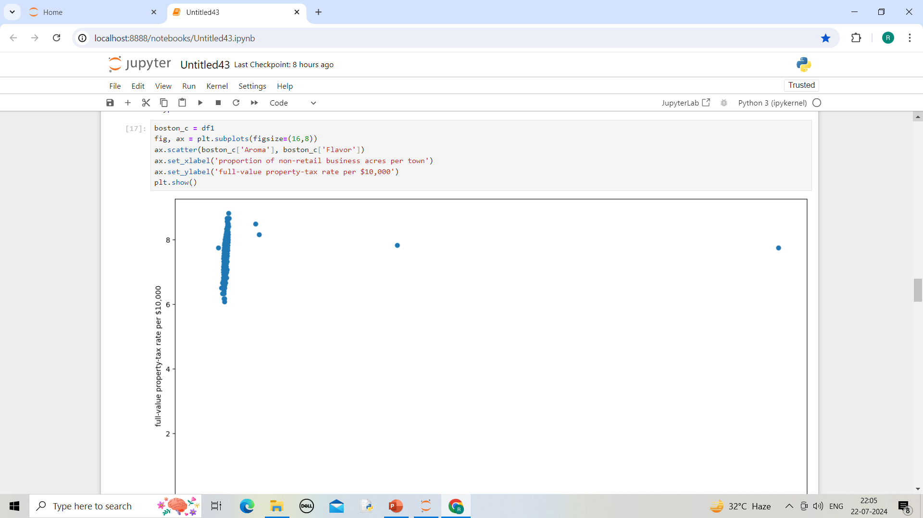

Slide 10
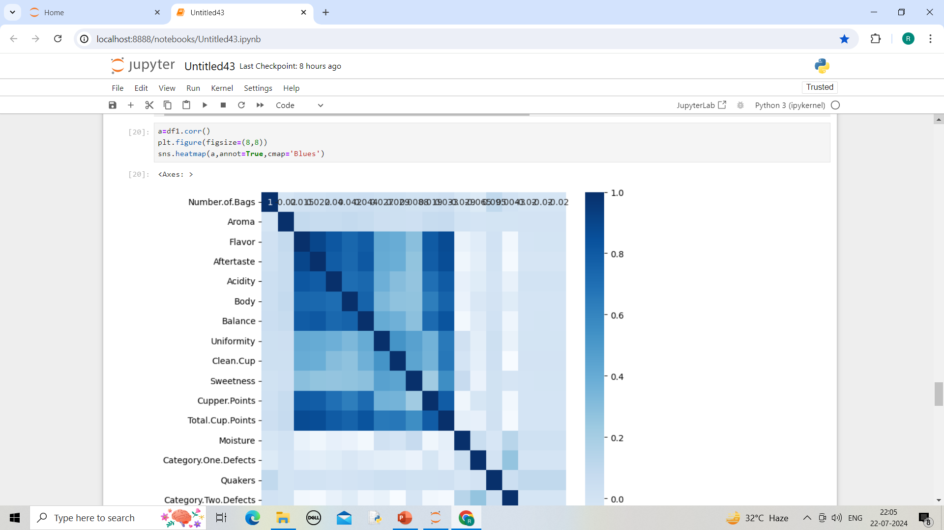
Heat map
It is uded to see most correlate area
Most correlated area show dark blue
Least correlated area shows lite blue

Slide 11
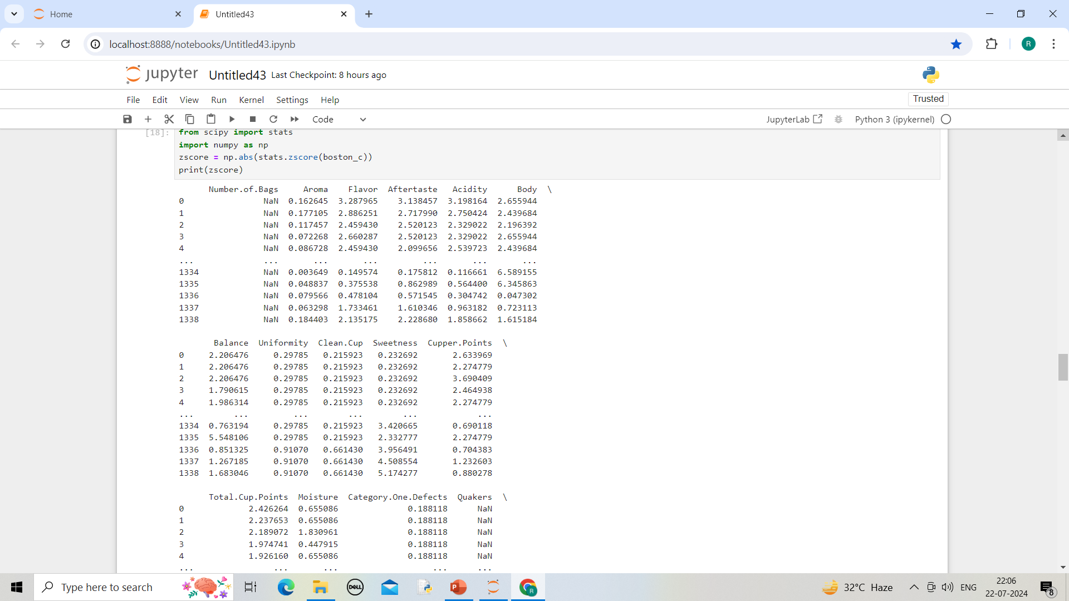
zscore

Slide 12
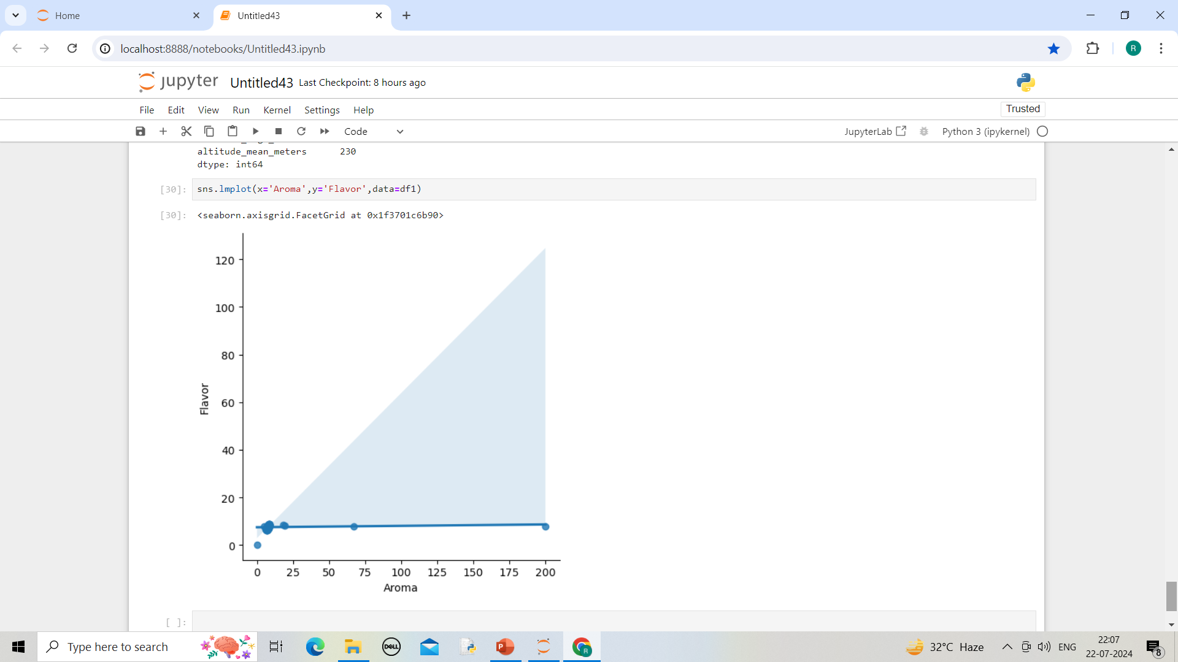
Lmplot

Slide 13
Thank you

